Slide 1
Module 3: Playbooks

Slide 2
What is playbook, understanding the anatomy of a playbook and running a playbook
How to create reusable playbooks
Roles
Variables and modules
Understanding inventory file and how to use it for scaling to multiple hosts
Creating the Ansible user
Jinja2 Templates
Conditionals
Variables
Filters

Slide 3
Topic List
What is playbook, understanding the anatomy of a playbook and running a playbook
How to create reusable playbooks
Roles,
Variables and modules
Understanding inventory file and how to use it for scaling to multiple hosts
Creating the Ansible user
Jinja2 Templates
Conditionals & Filters

Slide 4
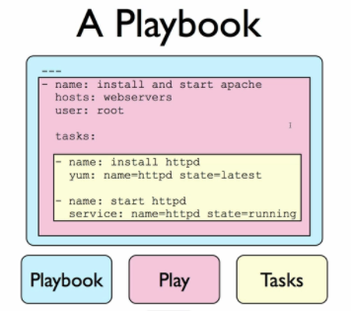
Ansible Playbooks
What is playbook
Like many other configuration management solutions, Ansible uses a metaphor to describe its configuration files. They are called ‘playbooks’, and they list a set of tasks (‘plays’ in Ansible parlance) that will be run against a particular server or set of servers.
In Ansible, you write playbooks (a list of instructions describing the steps to bring your server to a certain configuration state) that are then played on your servers.
Playbooks are written in YAML, a simple human-readable syntax popular for defining configuration. Playbooks may be included within other playbooks, and certain metadata and options cause different plays or playbooks to be run in different scenarios on different servers.
Ad-hoc commands alone make Ansible a powerful tool;
playbooks turn Ansible into a top-notch server provisioning
and configuration management tool.
Notes:
In American football, a team follows a set of pre-written playbooks as the basis for a bunch of plays they execute to try to win a game.
What attracts most DevOps personnel to Ansible is the fact that it is easy to convert shell scripts (or one-off shell commands) directly into Ansible plays.

Slide 5

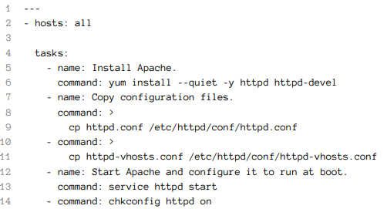
Ansible Playbooks
Ansible Playbook
To run the Ansible Playbook (in this case, a file named playbook.yml with the contents as above), you would call it using the ansible-playbook command:
# (From the same directory in which the playbook resides). $ ansible-playbook playbook.yml

Slide 6
Running Playbooks with ansible-playbook
Limiting playbooks to particular hosts and groups
You can limit a playbook to specific groups or individual hosts by changing the hosts: definition.
The value can be set to all hosts, a group of hosts defined in your inventory, multiple groups of hosts (e.g. webservers, dbservers), individual hosts (e.g. atl.example.com), or a mixture of hosts. You can even do wild card matches, like *.example.com, to match all subdomains of a top-level domain.
You can also limit the hosts on which the playbook is run via the ansible-playbook
command: $ ansible-playbook playbook.yml --limit webservers
In this case (assuming your inventory file contains a webservers group), even if the playbook is set to hosts: all, or includes hosts in addition to what’s defined in the webservers group, it will only be run on the hosts defined in webservers.
You could also limit the playbook to one particular host:
$ ansible-playbook playbook.yml --limit xyz.example.com
If you want to see a list of hosts that would be affected by your playbook before you
actually run it, use --list-hosts:
$ ansible-playbook playbook.yml --list-hosts
Notes:
Running this should give output like:
playbook: playbook.yml
play #1 (all): host count=4
127.0.0.1
192.168.24.2
foo.example.com
bar.example.com
(Where count is the count of servers defined in your inventory, and following is a
list of all the hosts defined in your inventory).

Slide 7
Setting user and sudo options with ansible-playbook
If no remote_user is defined alongside the hosts in a playbook, Ansible assumes you’ll connect as the user defined in your inventory file for a particular host, and then will fall back to your local user account name. You can explicitly define a remote user to use for remote plays using the --remote-user (-u) option:
$ ansible-playbook playbook.yml --remote-user=johndoe
For example, the following command will run our example playbook with sudo, performing the tasks as the sudo user janedoe, and Ansible will prompt you for the sudo password:
$ ansible-playbook playbook.yml --become --become-user=janedoe \
--ask-become-pass
If you’re not using key-based authentication to connect to your servers (read my warning about the security mplications of doing so in Chapter 1), you can use --
ask-pass.
Notes:
In some situations, you will need to pass along your sudo password to the remote server to perform commands via sudo. In these situations, you’ll need use the --askbecome-pass (-K) option. You can also explicitly force all tasks in a playbook to use sudo with --become (-b. Finally, you can define the sudo user for tasks run via sudo
(the default is root) with the --become-user (-U) option.

Slide 8
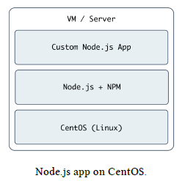
Real-world playbook: CentOS Node.js app server
The first example, while being helpful for someone who might want to post a simple static web page to a clunky old Apache server, is not a good representation of a real-world scenario. I’m going to run through more complex playbooks that do many different things, most of which are actually being used to manage production infrastructure today.
The first playbook will configure a CentOS server with Node.js, and install and start a simple Node.js application. The server will have a very simple architecture:
To start things off, we need to create a YAML file (playbook.yml in this example) to
contain our playbook. Let’s keep things simple:
1 ---
2 - hosts: all
3
4 tasks:
Notes:
First, define a set of hosts (all) on which this playbook will be run (see the section
above about limiting the playbook to particular groups and hosts), then tell Ansible
that what follows will be a list of tasks to run on the hosts

Slide 9
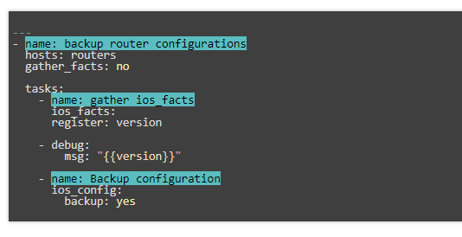
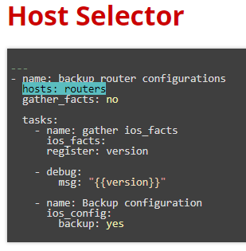
Human-Meaningful Naming

Slide 10
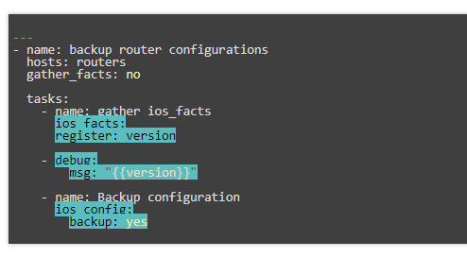
Tasks

Slide 11
Modules
Modules do the actual work in ansible, they are what gets executed in each playbook task. But you can also run a single one using the ‘ansible’ command.
ios_banner
ios_command
ios_config
ios_facts
ios_interface
ios_logging
ios_ping
ios_static_route
ios_system
ios_user
also supported: eos_ (Arista) junos_(Juniper), etc

Slide 12
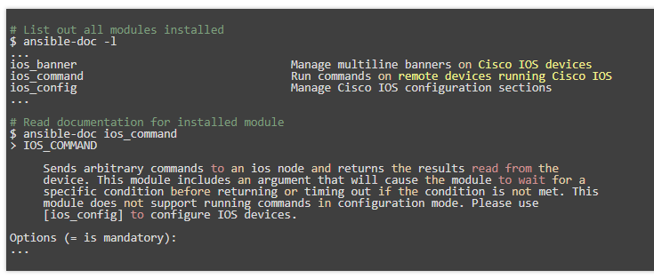
Modules Documentation

Slide 13
Modules: Run Commands
If Ansible doesn’t have a module that suits your needs there are the “run command” modules:
command: Takes the command and executes it on the host. The most secure and predictable.
shell: Executes through a shell like /bin/sh so you can use pipes etc. Be careful.
script: Runs a local script on a remote node after transferring it.
raw: Executes a command without going through the Ansible module subsystem.
ios_command: Sends arbitrary commands to an ios node and returns the results read from the device.
NOTE: Unlike standard modules, run commands have no concept of desired state and should
only be used as a last resort.

Slide 14
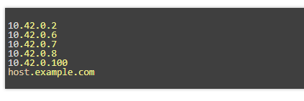
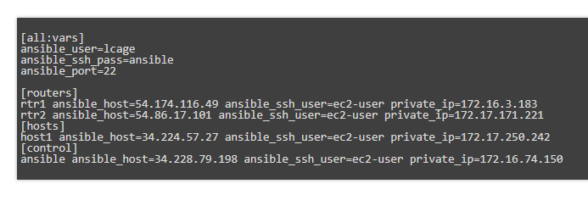
Inventory
Inventory is a collection of hosts (nodes) with associated data and groupings that Ansible can connect and manage.
Hosts (nodes)
Groups
Inventory-specific data (variables)
Static or dynamic sources
STATIC INVENTORY EXAMPLE

Slide 15
Ad-Hoc Commands
Common Options
An ad-hoc command is a single Ansible task to perform quickly, but don’t want to save for later.
-m MODULE_NAME, --module-name=MODULE_NAME Module name to execute the ad-hoc command
-a MODULE_ARGS, --args=MODULE_ARGS Module arguments for the ad-hoc command
-b, --become Run ad-hoc command with elevated rights such as sudo, the default method
-e EXTRA_VARS, --extra-vars=EXTRA_VARS Set additional variables as key=value or YAML/JSON
--version Display the version of Ansible
--help Display the MAN page for the ansible tool

Slide 16
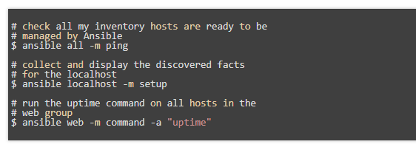
Adhoc Commands

Slide 17
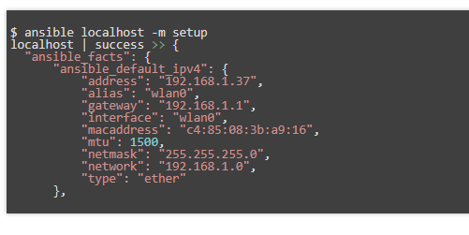
Sidebar: Discovered Facts
Facts are bits of information derived from examining a host systems that are stored as variables for later use in a play.

Slide 18
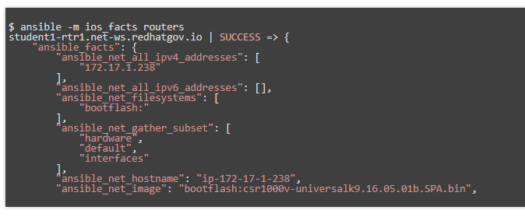
Sidebar: Network Facts
For non-Linux systems there are vendor specific modules for fact collection.

Slide 19
Variables
Ansible can work with metadata from various sources and manage their context in the form of variables.
Command line parameters
Plays and tasks
Files
Inventory
Discovered facts
Roles

Slide 20
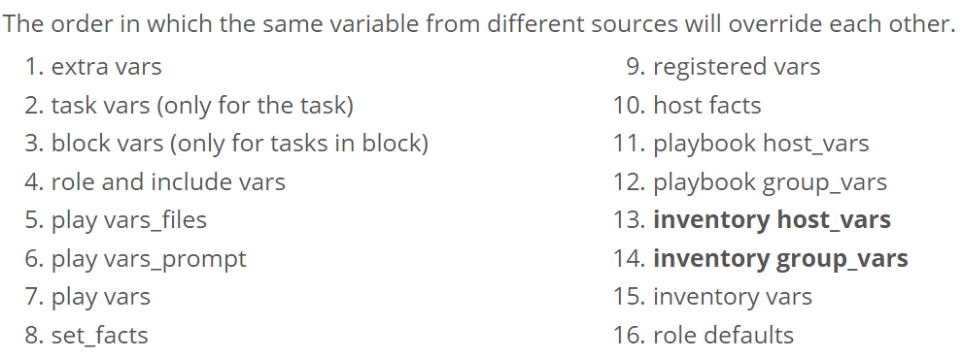
Variable Precedence

Slide 21
Tasks
Tasks are the application of a module to perform a specific unit of work.
file: A directory should exist
yum: A package should be installed
service: A service should be running
template: Render a configuration file from a template
get_url: Fetch an archive file from a URL
There are also tasks for network devices as well
ios_facts: collect the version of code running
ios_system: configure DNS server(s)
nxos_snmp_user: add an SNMP user
eos_command: turn off a port
junos_banner: manage the banner

Slide 22
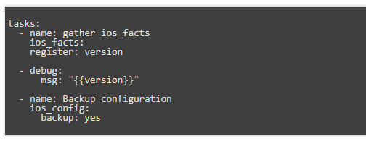
Example Tasks in a Play

Slide 23
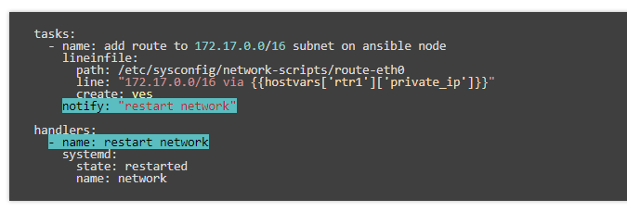
Handler Tasks
Handlers are special tasks that run at the end of a play if notified by another task when a change occurs.
If a switch is running a certain version of code, notify a task to create a backup

Slide 24
Doing More with Playbooks
Here are some more essential playbook features that you can apply:
Templates
Loops
Conditionals
Tags
Blocks

Slide 25
Roles
Roles are a packages of closely related Ansible content that can be shared more easily than plays alone.
Improves readability and maintainability of complex plays
Eases sharing, reuse and standardization of automation processes
Enables Ansible content to exist independently of playbooks, projects -- even organizations
Provides functional conveniences such as file path resolution and default values

Slide 26
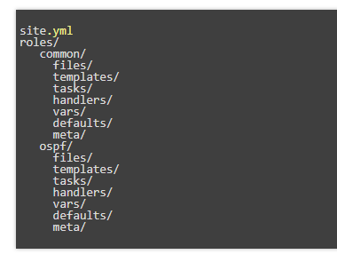
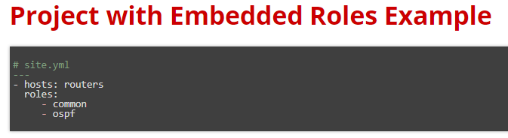
Project with Embedded Roles Example

Slide 27
Ansible Galaxy
http://galaxy.ansible.com
Ansible Galaxy is a hub for finding, reusing and sharing Ansible content.
Jump-start your automation project with content contributed and reviewed by the Ansible community.

Slide 28
What is playbook, understanding the anatomy of a playbook and running a playbook
How to create reusable playbooks
Roles
Variables and modules
Understanding inventory file and how to use it for scaling to multiple hosts
Creating the Ansible user
Jinja2 Templates
Conditionals
Variables
Filters

